Slide 1
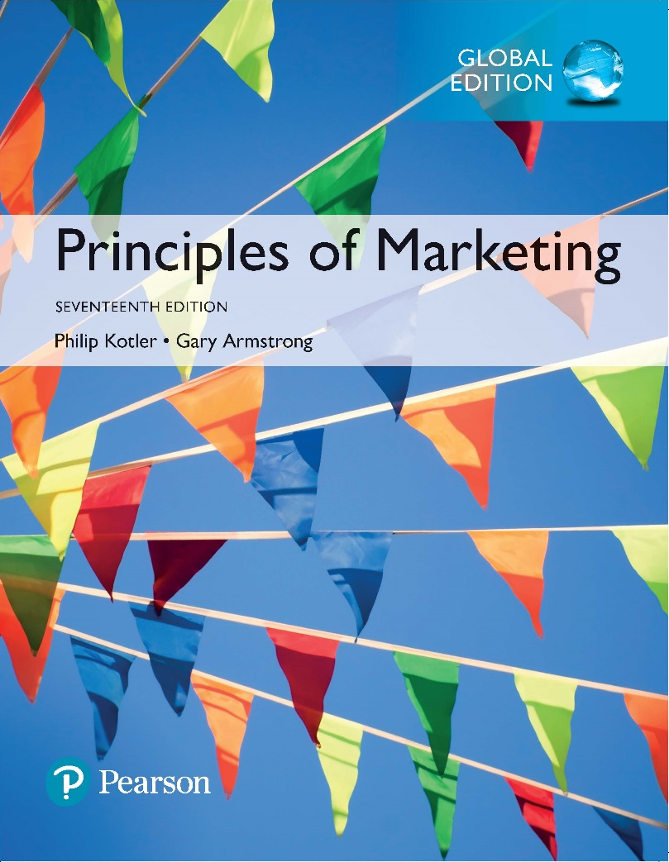
Principles of Marketing Seventeenth Edition
Chapter 7 Customer Value-Driven Marketing Strategy: Creating Value for Target Customers
Copyright © 2018 Pearson Education Ltd. All Rights Reserved.

Slide 2
Learning Objectives
7-1 Define the major steps in designing a customer-driven marketing strategy: market segmentation, targeting, differentiation, and positioning.
7-2 List and discuss the major bases for segmenting consumer and business markets.
7-3 Explain how companies identify attractive market segments and choose a market-targeting strategy.
7-4 Discuss how companies differentiate and position their products for maximum competitive advantage.

Slide 3
Learning Objective 1
Define the major steps in designing a customer-driven marketing strategy: market segmentation, targeting, differentiation, and positioning.

Slide 4
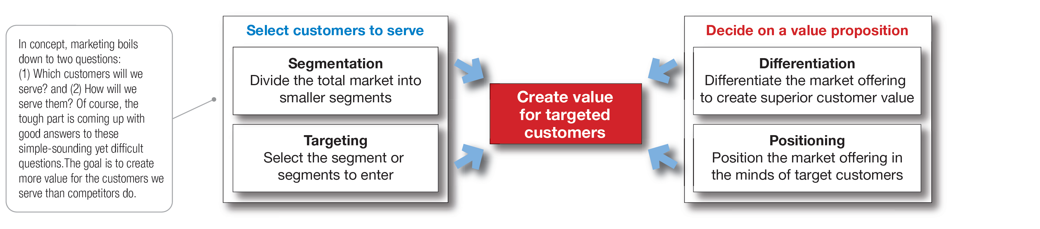
Customer-Driven Marketing Strategy
Notes:
Companies today recognize that they cannot appeal to all buyers in the marketplace—or at least not to all buyers in the same way. They must design customer-driven marketing strategies that build the right relationships with the right customers.
Thus, most companies have moved away from mass marketing and toward target marketing: identifying market segments, selecting one or more of them, and developing products and marketing programs tailored to each.
Figure 7.1 shows the four major steps in designing a customer-driven marketing strategy:
Segmentation
Targeting
Differentiation
Positioning
We will discuss each of these steps in turn.

Slide 5
Learning Objective 2
List and discuss the major bases for segmenting consumer and business markets.

Slide 6
Market Segmentation
Market segmentation requires dividing a market into smaller segments with distinct needs, characteristics, or behaviors that might require separate marketing strategies or mixes.
Important segmentation topics:
Segmenting consumer markets
Segmenting business markets
Segmenting international markets
Requirements for effective segmentation
Notes:
Buyers in any market differ in their wants, resources, locations, buying attitudes, and buying practices. Through market segmentation, companies divide large, heterogeneous markets into smaller segments that can be reached more efficiently and effectively with products and services that match their unique needs.
In Learning Objective 2, we will discuss four important segmentation topics: segmenting consumer markets, segmenting business markets, segmenting international markets, and the requirements for effective segmentation.

Slide 7
Market Segmentation
Segmenting Consumer Markets
Geographic segmentation
Demographic segmentation
Psychographic segmentation
Behavioral segmentation
Notes:
There is no single way to segment a market. A marketer has to try different segmentation variables, alone and in combination, to find the best way to view market structure. This visual outlines variables shown in Table 7.1 that might be used in segmenting consumer markets.

Slide 8
Market Segmentation
Segmenting Consumer Markets
Geographic segmentation divides the market into different geographical units such as nations, regions, states, counties, cities, or even neighborhoods.
Notes:
A company may decide to operate in one or a few geographical areas or operate in all areas but pay attention to geographical differences in needs and wants.
Many companies today are localizing their products, advertising, promotion, and sales efforts to fit the needs of individual regions, cities, and neighborhoods.
For example, Domino’s Pizza, the nation’s largest pizza delivery chain, keeps its marketing and customer focus decidedly local. Customers anywhere in the nation can use the online platform or smartphone app to track down local coupon offers, locate the nearest store with a GPS store locator, and quickly receive a freshly-made pizza. They can even use Domino’s Pizza Tracker to follow their pies locally from store to door.

Slide 9
Market Segmentation
Segmenting Consumer Markets
Demographic segmentation divides the market into segments based on variables such as age, life-cycle stage, gender, income, occupation, education, religion, ethnicity, and generation.
Age and life-cycle stage segmentation divides a market into different age and life-cycle groups.
Gender segmentation divides a market into different segments based on gender.
Income segmentation divides a market into different income segments.
Notes:
Demographic factors are the most popular bases for segmenting customer groups. One reason is that consumer needs, wants, and usage rates often vary closely with demographic variables. Demographic variables are easier to measure than most other types of variables.
Even when marketers first define segments using other bases, such as benefits sought or behavior, they must know a segment’s demographic characteristics to assess the size of the target market and reach it efficiently.

Slide 10
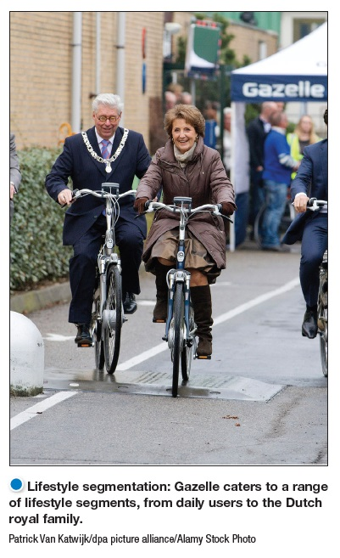
Market Segmentation
Segmenting Consumer Markets
Psychographic segmentation divides a market into different segments based on social class, lifestyle, or personality characteristics.
Notes:
Psychographic segmentation: Dunkin’ Donuts successfully targets the “Dunkin’ tribe”—not the Starbucks coffee snob but the average Joe. Dunkin’ Donuts isn’t like Starbucks—it doesn’t want to be.”
People in the same demographic group can have very different psychographic characteristics.
In Chapter 5, we discussed how the products people buy reflect their lifestyles. Marketers also use personality variables to segment markets. For example, different soft drinks target different personalities. Mountain Dew projects a youthful, rebellious, adventurous personality whereas Coca-Cola Zero appeals to target personality types which are more mature, practical, and cerebral but good-humored. Its subtly humorous ads promise “Real Coca-Cola taste and zero calories.”

Slide 11
Market Segmentation
Segmenting Consumer Markets
Behavioral segmentation divides a market into segments based on consumer knowledge, attitudes, uses of a product, or responses to a product.
Notes:
Many marketers believe that behavior variables are the best starting point for building market segments.

Slide 12
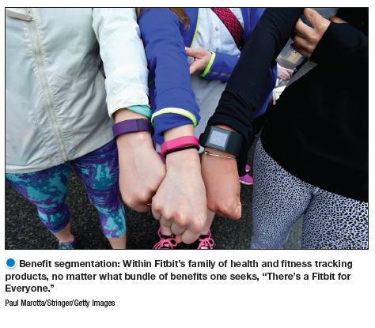
Market Segmentation
Segmenting Consumer Markets
Behavioral Segmentation
Occasions
Benefits sought
User status
Usage rate
Loyalty status
Notes:
Benefit segmentation: Schwinn makes bikes for every benefit segment. For example, Schwinn’s urban bikes are “for riders who want a functional, durable, and stylish bike to commute or ride casually in urban areas.”
Occasions refer to when consumers get the idea to buy, actually make their purchase, or use the purchased item. Occasion segmentation can help firms build up product usage. Campbell’s advertises its soups more heavily in the cold winter months, and Home Depot runs special springtime promotions for lawn and gardens products. Other marketers prepare special offers and ads for holiday occasions or nontraditional occasions.
Benefits sought refers to finding the major benefits people look for in a product class, the kinds of people who look for each benefit, and the major brands that deliver each benefit.
Markets can be segmented by user status: nonusers, ex-users, potential users, first-time users, and regular users of a product. Marketers want to reinforce and retain regular users, attract targeted nonusers, and reinvigorate relationships with ex-users.
Markets can also be segmented by usage rate: light, medium, and heavy product users. Heavy users are often a small percentage of the market but account for a high percentage of total consumption. For instance, a recent study showed that heavy seafood consumers in the United States are a small but hungry bunch. Less than 5 percent of all shoppers buy nearly 64 percent of unbreaded seafood consumed in the United States.
Consumers can be loyal to brands, and buyers can be divided into groups according to their degree of loyalty. Some consumers are completely loyal—they buy one brand all the time and can’t wait to tell others about it. Other consumers are somewhat loyal—they are loyal to two or three brands of a given product or favor one brand while sometimes buying others. Still other buyers show no loyalty to any brand—they either want something different each time they buy, or they buy whatever’s on sale. A company can learn a lot by analyzing loyalty patterns in its market, starting with its own loyal customers.

Slide 13
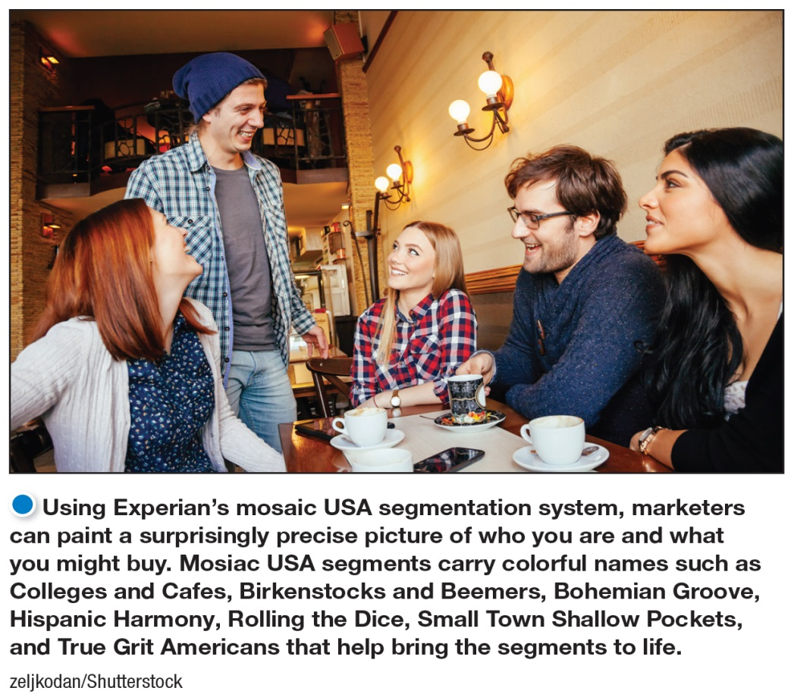
Market Segmentation
Segmenting Consumer Markets
Multiple segmentation is used to identify smaller, better-defined target groups.
Several business information services like Experian provide multivariable segmentation systems that merge geographic, demographic, lifestyle, and behavioral data to help companies segment their markets down to zip codes, neighborhoods, and even households.
Experian’s Mosaic USA system classifies U.S. households into one of 71 lifestyle segments and 19 levels of affluence.
Notes:
Marketers rarely limit their segmentation analysis to only one or a few variables. Rather, they often use multiple segmentation bases in an effort to identify smaller, better defined target groups. Several business information services like Experian provide multivariable segmentation systems that merge geographic, demographic, lifestyle, and behavioral data to help companies segment their markets down to zip codes, neighborhoods, and even households.
One of the leading consumer segmentation systems is Experian’s Mosaic USA system. Mosaic USA segments carry exotic names such as Birkenstocks and Beemers, Bohemian Groove, Sports Utility Families, Colleges and Cafes, Hispanic Harmony, Rolling the Dice, Small Town Shallow Pockets, and True Grit Americans. Such colorful names help bring the segments to life.
Mosaic USA can help marketers to segment people and locations into marketable groups of like-minded consumers. Each segment has its own pattern of likes, dislikes, lifestyles, and purchase behaviors.
Such rich segmentation provides a powerful tool for marketers of all kinds. It can help companies identify and better understand key customer segments, reach them more efficiently, and tailor market offerings and messages to their specific needs.

Slide 14
Market Segmentation
Segmenting Business Markets
Consumer and business marketers use many of the same variables to segment their markets.
Additional variables for business include:
Customer operating characteristics
Purchasing approaches
Situational factors
Personal characteristics of buyers
Notes:
Consumer and business marketers can be segmented geographically, demographically (industry, company size), or by benefits sought, user status, usage rate, and loyalty status. Yet, business marketers also use some additional variables.
Customer operating characteristics: technology in use, users or nonusers, need few or many services.
Purchasing approaches: centralized or decentralized in purchase, leasing or purchasing, seeking quality, services, or price
Situational factors
: urgency, specific application or general application of the product, small and big orders.
Personal characteristics of buyers: their demographic characteristics, decision style, tolerance for risk, confidence level , job responsibilities ... Etc. influence their buying behavior and thus offer a viable basis for segmenting some business markets.
Almost every company serves at least some business markets. For example, Starbucks has developed distinct marketing programs for each of its two business segments: the office coffee and food service segments.
Many companies establish separate systems for dealing with larger or multiple-location customers. For example, Steelcase, a major producer of office furniture, first divides customers into seven segments, and salespeople work with independent Steelcase dealers to handle smaller, local, or regional Steelcase customers in each segment.
Many national, multiple-location customers, such as ExxonMobil or IBM, have special needs that may reach beyond the scope of individual dealers. Therefore, Steelcase uses national account managers to help its dealer networks handle national accounts.

Slide 15
Market Segmentation
Segmenting International Markets
Geographic location
Economic factors
Political and legal factors
Cultural factors
Notes:
Few companies have either the resources or the will to operate in all, or even most, of the countries that dot the globe. Operating in many countries presents new challenges. Different countries, even those that are close together, can vary greatly in their economic, cultural, and political makeup. International firms need to group their world markets into segments with distinct buying needs and behaviors. Companies can segment international markets using one or a combination of several variables:
Geographic location involves grouping countries by regions such as Western Europe, the Pacific Rim, the Middle East, or Africa. Geographic segmentation assumes that nations close to one another will have many common traits and behaviors, however there are many exceptions. For example, the Dominican Republic is no more like Brazil than Italy is like Sweden. Many Central and South Americans don’t even speak Spanish.
Economic factors involve grouping countries by population income levels or by their overall level of economic development. A country’s economic structure shapes its population’s product and service needs and, therefore, the marketing opportunities it offers.
Political and legal factors involve segmenting by the type and stability of the government, government receptivity to foreign firms, monetary regulations, and the amount of bureaucracy.
Cultural factors involve grouping markets according to common languages, religions, values and attitudes, customs, and behavioral patterns.

Slide 16
Market Segmentation
Segmenting International Markets
Intermarket segmentation involves forming segments of consumers who have similar needs and buying behaviors even though they are located in different countries.
Notes:
Segmenting international markets based on geographic, economic, political, cultural, and other factors presumes that segments should consist of clusters of countries.
However, as new communications technologies, such as satellite TV and the Internet, connect consumers around the world, marketers can define and reach segments of like-minded consumers no matter where in the world they are using intermarket segmentation (also called cross-market segmentation.)

Slide 17
Market Segmentation
Requirements for Effective Segmentation
Measurable
Accessible
Substantial
Differentiable
Actionable
Notes:
Measurable: The size, purchasing power, and profiles of the segments can be measured.
Accessible: The market segments can be effectively reached and served.
Substantial: The market segments are large or profitable enough to serve.
Differentiable: The segments are conceptually distinguishable and respond differently to different marketing mix elements and programs.
Actionable: Effective programs can be designed for attracting and serving the segments.

Slide 18
Learning Objective 3
Explain how companies identify attractive market segments and choose a market-targeting strategy.
Notes:
After dividing the market into segments, it’s time to answer that first seemingly simple marketing strategy question we raised in Figure 7.1: Which customers will the company serve?
The firm now has to decide how many and which segments it can serve best. We now look at how companies evaluate and select target segments.

Slide 19
Market Targeting
Evaluating Market Segments
Segment size and growth
Segment structural attractiveness
Company objectives and resources
Notes:
Selecting segments that have the right size and growth characteristics is a relative matter. The largest, fastest-growing segments are not always the most attractive ones for every company. Smaller companies may target segments that are smaller and less attractive, in an absolute sense, but that are potentially more profitable for them.
Structural factors that affect long-run segment attractiveness include strong and aggressive competitors, new entrants, substitute products, power of buyers relative to sellers, and powerful suppliers who can control prices, quality, or quantity of ordered goods and services.
Some attractive segments can be dismissed quickly because they do not mesh with the company’s long-run objectives. Or the company may lack the skills and resources needed to succeed in an attractive segment. A company should only enter segments in which it can create superior customer value and gain advantages over its competitors.

Slide 20
Market Targeting
Selecting Target Market Segments
A target market is a set of buyers who share common needs or characteristics that the company decides to serve.
Notes:
After evaluating different segments, the company must decide which and how many segments it will target. Market targeting can be carried out at several different levels as shown in the next slide.

Slide 21
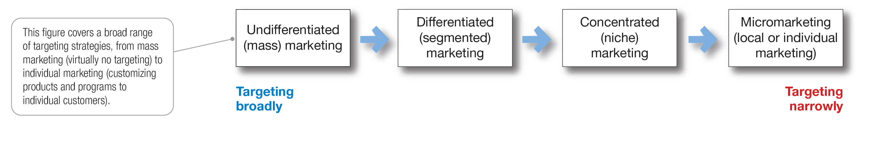
Market Targeting
Figure 7.2 Market-Targeting Strategies.
Notes:
Figure 7.2 shows that companies can target very broadly (undifferentiated marketing), very narrowly (micromarketing), or somewhere in between (differentiated or concentrated marketing).
This figure covers a broad range of targeting strategies, from mass marketing (virtually no targeting) to individual marketing (customizing products and programs to individual customers). An example of individual marketing is candy lovers can buy M&M’s embossed with images of their kids or pets.

Slide 22
Market Targeting
Selecting Target Market Segments
Undifferentiated marketing targets the whole market with one offer.
Mass marketing
Focuses on common needs rather than what’s different
Notes:
With undifferentiated marketing (or mass marketing), the company designs a product and a marketing program that will appeal to the largest number of buyers.
As noted in the chapter, most modern marketers have strong doubts about this strategy. Difficulties arise in developing a product or brand that will satisfy all consumers. Moreover, mass marketers often have trouble competing with more-focused firms that do a better job of satisfying the needs of specific segments and niches.

Slide 23
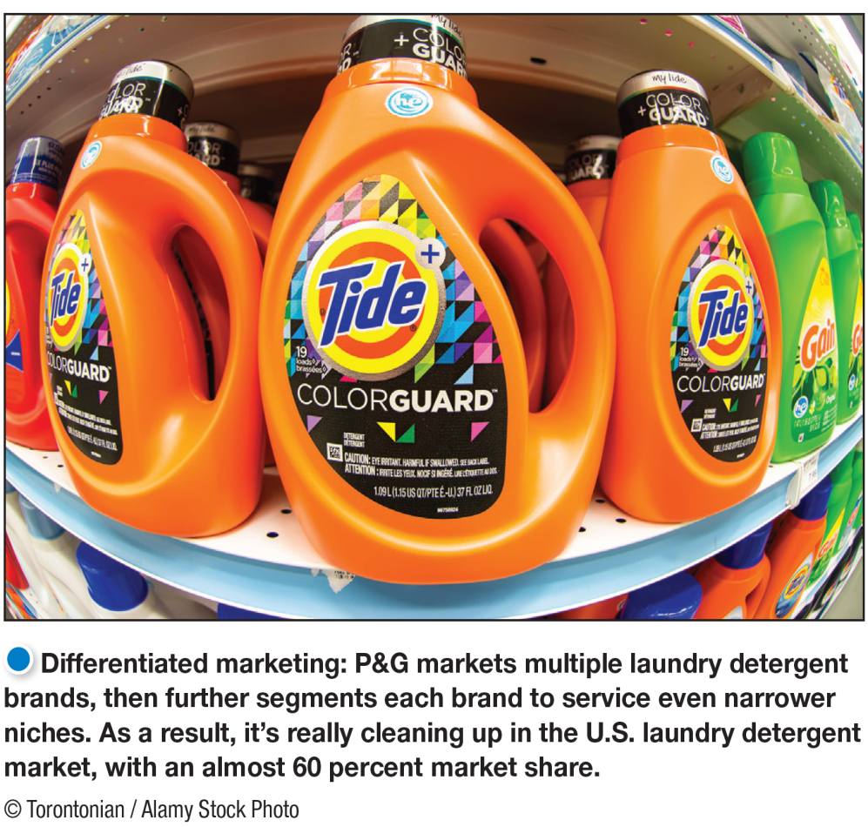
Market Targeting
Selecting Target Market Segments
Differentiated marketing targets several different market segments and designs separate offers for each.
Goal is to achieve higher sales and stronger position
More expensive than undifferentiated marketing
Notes:
P&G markets six different laundry detergent brands in the United States, which compete with each other on supermarket shelves. Then, P&G further segments each brand to serve even narrower niches.
Developing a stronger position within several segments creates more total sales than undifferentiated marketing across all segments. Hallmark’s differentiated brands account for more than 44 percent of the greeting cards purchased in the United States. Similarly, P&G’s multiple detergent brands capture four times the market share of its nearest rival.
Differentiated marketing increases the costs of doing business. The company must weigh increased sales against increased costs when deciding on a differentiated marketing strategy.

Slide 24
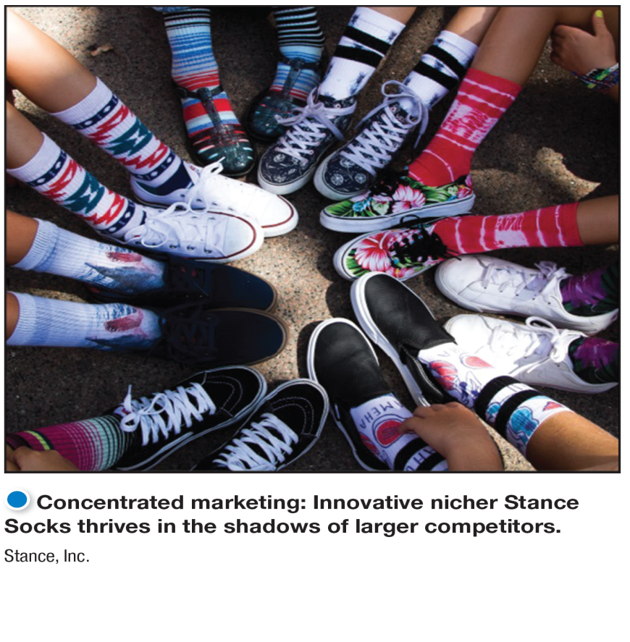
Market Targeting
Selecting Target Markets
Concentrated marketing targets a large of a smaller market.
Limited company resources
Knowledge of the market
More effective and efficient
Notes:
Concentrated marketing: When using a concentrated marketing (or niche marketing) strategy, a firm goes after a large share of one or a few smaller segments or niches. For example, Stance Socks thrives with high-quality, colorful sock sold through high-end department stores.
Today, the low cost of setting up shop on the Internet makes it even more profitable to serve seemingly miniscule niches. Small businesses, in particular, are realizing riches from serving small niches on the Web.
Concentrated marketing can be highly profitable. At the same time, it involves higher-than-normal risks. Companies that rely on one or a few segments for all of their business will suffer greatly if the segment turns sour. Or larger competitors may decide to enter the same segment with greater resources. For these reasons, many companies prefer to diversify in several market segments. In fact, many large companies develop or acquire niche brands of their own.

Slide 25
Market Targeting
Selecting Target Market Segments
Micromarketing is the practice of tailoring products and marketing programs to suit the tastes of specific individuals and locations.
Local marketing
Individual marketing
Notes:
Rather than seeing a customer in every individual, micromarketers see the individual in every customer. Micromarketing includes local marketing and individual marketing described on the next slides.

Slide 26
Market Targeting
Selecting Target Market Segments
Local marketing involves tailoring brands and promotion to the needs and wants of local customer segments.
Cities
Neighborhoods
Stores
Notes:
Local marketing involves tailoring brands and promotions to the needs and wants of local customer groups—cities, neighborhoods, and even specific stores. For example, department store chain Macy’s has rolled out a localization program called My Macy’s in which merchandise is customized under 69 different geographical districts.
Advances in communications technology have given rise to new high-tech versions of location-based marketing. Thanks to the explosion in net-connected
smartphones with GPS capabilities and location-based social networks, companies can now track consumers’ whereabouts closely and gear their offers accordingly.
Increasingly, location-based marketing is going mobile, reaching on-the-go consumers as they come and go in key local market areas.
Discussion Question
What are the drawbacks of local marketing?
Local marketing has some drawbacks. It can drive up manufacturing and marketing costs by reducing the economies of scale. It can also create logistics problems as companies try to meet the varied requirements of different regional and local markets. Still, as companies face increasingly fragmented markets, and as new supporting technologies develop, the advantages of local marketing often outweigh the drawbacks. In addition, a brand’s overall image might be diluted if the product and message vary too much in different localities.

Slide 27
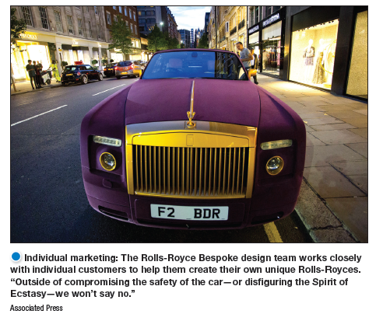
Market Targeting
Selecting Target Markets
Individual marketing involves tailoring products and marketing programs to the needs and preferences of individual customers.
Also known as:
One-to-one marketing
Mass customization
Notes:
In the extreme, micromarketing becomes individual marketing— one-to-one or markets-of-one marketing.
More detailed databases, robotic production and flexible manufacturing, and interactive media such as mobile phones and the Internet have combined to foster mass customization. Mass customization is the process by which firms interact one-to-one with masses of customers to design products and services tailor-made to individual needs. Individual marketing has made relationships with customers more important than ever.
The world appears to be coming full circle—from the good old days when customers were treated as individuals to mass marketing when nobody knew your name and then back again.

Slide 28
Market Targeting
Selecting Target Market Segments
Choosing a targeting strategy depends on:
Company resources
Product variability
Product life-cycle stage
Market variability
Competitor’s marketing strategies
Notes:
As shown in the slide, companies need to consider many factors when choosing a market-targeting strategy.
When the firm’s resources are limited, concentrated marketing makes the most sense. Undifferentiated marketing is more suited for uniform products, such as grapefruit or steel.
When a firm introduces a new product, it may be practical to launch one version only, as undifferentiated marketing or concentrated marketing may make the most sense.
In the mature stage of the product life cycle, however, differentiated marketing often makes more sense.
Undifferentiated marketing is appropriate where there is little market variability - most buyers have the same tastes, buy the same amounts, and react the same way to marketing efforts.
When competitors use undifferentiated marketing, a firm can gain an advantage by using differentiated or concentrated marketing, focusing on the needs of buyers in specific segments.

Slide 29
Learning Objective 4
Discuss how companies differentiate and position their products for maximum competitive advantage.

Slide 30
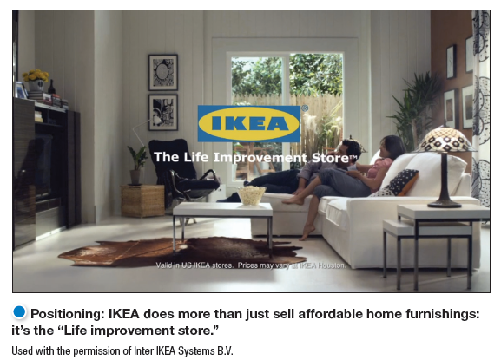
Differentiation and Positioning
Product position is the way the product is defined by consumers on important attributes.
Notes:
Positioning: IKEA does more than just sell affordable home furnishings; it’s the “Life improvement store.”
The company must decide on a value proposition—how it will create differentiated value for targeted segments and what positions it wants to occupy in those segments. The place the product occupies in consumers’ minds relative to competing products is the position. Products are made in factories, but brands happen in the minds of consumers.
Dreft is positioned as the gentle detergent for baby clothes; at IHOP, you “Come hungry. Leave happy.”; at Olive Garden, “When You’re Here, You’re Family.” In the automobile market, the Nissan Versa and Honda Fit are positioned on economy, Mercedes and Cadillac on luxury, and Porsche and BMW on performance.
To simplify the buying process, consumers organize products, services, and companies into categories and “position” them in their minds. A product’s position is the complex set of perceptions, impressions, and feelings that consumers have for the product compared with competing products.
Consumers position products with or without the help of marketers. But marketers do not want to leave their products’ positions to chance. They must plan positions that will give their products the greatest advantage in selected target markets, and they must design marketing mixes to create these planned positions.

Slide 31
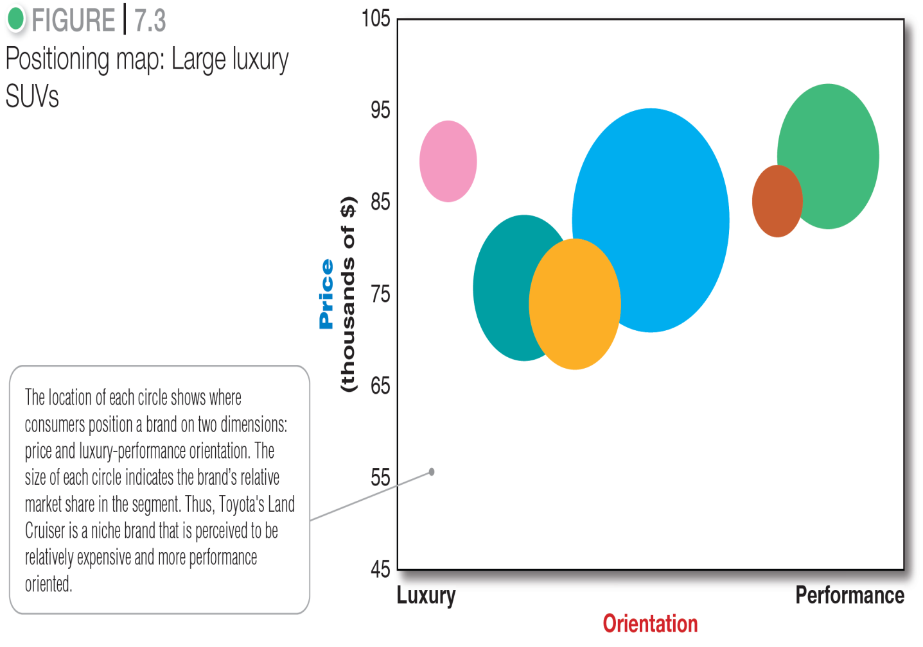
Differentiation and Positioning
Positioning maps show consumer perceptions of marketer’s brands versus competing products on important buying dimensions.
Notes:
In planning their differentiation and positioning strategies, marketers often prepare perceptual positioning maps. The position of each circle on the map indicates the brand’s perceived positioning on two dimensions: price and orientation (luxury versus performance). The size of each circle indicates the brand’s relative market share.

Slide 32
Differentiation and Positioning
Choosing a Differentiation and Positioning Strategy
Identifying a set of possible competitive advantages to build a position
Choosing the right competitive advantages
Selecting an overall positioning strategy
Communicating and delivering the chosen position to the market
Notes:
Firms must differentiate their offers by building a unique bundle of benefits that appeals to a substantial group within the segment. Above all else, a brand’s positioning must serve the needs and preferences of well-defined target markets.
For example, although both Dunkin’ Donuts and Starbucks are coffee and snack shops, they target very different customers, who want very different things from their favorite coffee seller. Starbucks targets more upscale professionals with more high-brow positioning. In contrast, Dunkin’ Donuts targets the “average Joe” with a decidedly more low-brow, “everyman” kind of positioning. Yet each brand succeeds because it creates just the right value proposition for its unique mix of customers

Slide 33
Differentiation and Positioning
Choosing a Differentiation and Positioning Strategy
Competitive advantage is an advantage over competitors gained by offering consumers greater value, either through lower prices or by providing more benefits that justify higher prices.
Notes:
To build profitable relationships with target customers, marketers must understand customer needs and deliver more customer value better than competitors do. To the extent that a company can differentiate and position itself as providing superior customer value, it gains competitive advantage.
But solid positions cannot be built on empty promises. If a company positions its product as offering the best quality and service, it must actually differentiate the product so that it delivers the promised quality and service. Companies must do much more than simply shout out their positions with slogans and taglines. They must first live the slogan.

Slide 34
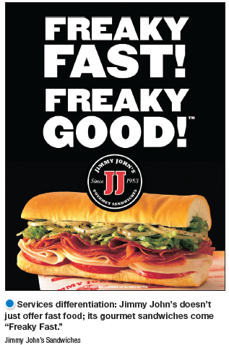
Differentiation and Positioning
Choosing a Differentiation and Positioning Strategy
Identifying a set of possible competitive advantages to differentiate along the lines of:
Product
Services
Channels
People
Image
Notes:
Product differentiation: Premium audio brand Bose promises “better sound through research—an innovative, high-quality listening experience.”
To find points of differentiation, marketers must think through the customer’s entire experience with the company’s product or service. An alert company can find ways to differentiate itself at every customer contact point.
Through product differentiation, brands can be differentiated on features, performance, or style and design. Thus, Bose positions its speakers on their striking design and sound characteristics. By gaining the approval of the American Heart Association as an approach to a healthy lifestyle, Subway differentiates itself as the healthy fast-food choice.
Some companies gain services differentiation through speedy, convenient, or careful delivery. For example, Jimmy John’s doesn’t just offer fast food; its gourmet sandwiches are “Freaky Fast.”
Firms that practice channel differentiation gain competitive advantage through the way they design their channel’s coverage, expertise, and performance. Amazon.com and GEICO, for example, set themselves apart with their smooth-functioning direct channels.
Companies can also gain a strong competitive advantage through people differentiation—hiring and training better people than their competitors do.
Even when competing offers look the same, buyers may perceive a difference based on company or brand image differentiation. The chosen symbols, characters, and other image elements a brand chooses must be communicated through advertising that conveys the company’s or brand’s personality.

Slide 35
Differentiation and Positioning
Choosing a Differentiation and Positioning Strategy
A competitive advantage should be:
Distinctive
Superior
Communicable
Preemptive
Affordable
Profitable
Important
Notes:
Discussion Question
Are you familiar with GEICO advertisements? If so, what is their positioning?
Not all brand differences are meaningful or worthwhile, and each difference has the potential to create company costs as well as customer benefits. A difference is worth establishing to the extent that it satisfies the following criteria:
Important: The difference delivers a highly valued benefit to target buyers.
Distinctive: Competitors do not offer the difference, or the company can offer it in a more distinctive way.
Superior: The difference is superior to other ways that customers might obtain the same benefit.
Communicable: The difference is communicable and visible to buyers.
Preemptive: Competitors cannot easily copy the difference.
Affordable: Buyers can afford to pay for the difference.
Profitable: The company can introduce the difference profitably.
Many companies have introduced differentiations that failed one or more of these tests. Choosing competitive advantages on which to position a product or service can be difficult, yet such choices may be crucial to success. Choosing the right differentiators can help a brand stand out from the pack of competitors. For example, when Nokia introduced its Lumia 1020 smartphone, it didn’t position the phone only on attributes shared with competing models, such as user interface and speed. It positioned it as a smartphone with a 41 megapixel camera with a “reinvented zoom” and “full HD video” that fits today’s digital lifestyles.

Slide 36
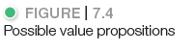
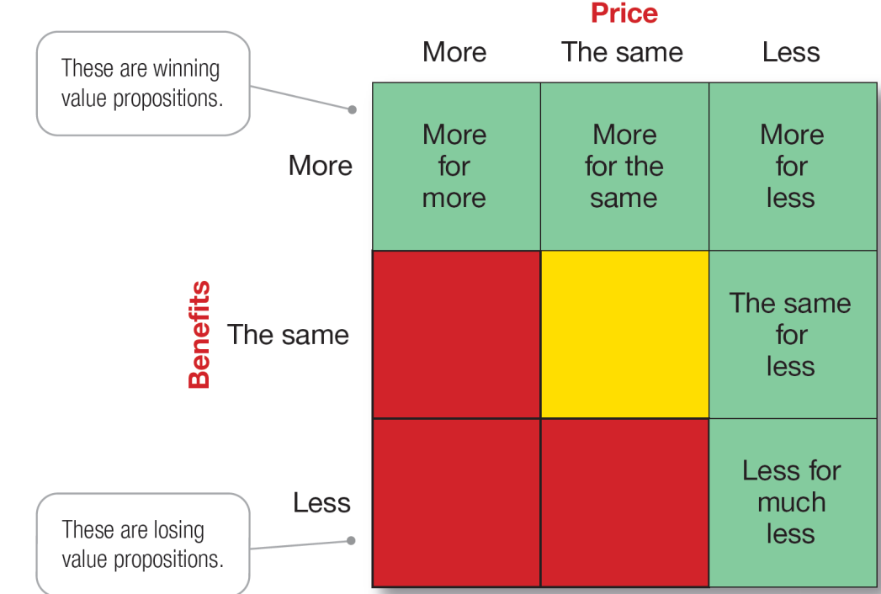
Differentiation and Positioning
Choosing a Differentiation and Positioning Strategy
Value proposition is the full mix of benefits upon which a brand is positioned.
Notes:
The full positioning of a brand is called the brand’s value proposition—the full mix of benefits on which a brand is differentiated and positioned. It is the answer to the customer’s question “Why should I buy your brand?” BMW’s “ultimate driving machine” value proposition hinges on performance but also includes luxury and styling, all for a price that is higher than average but seems fair for this mix of benefits.
Figure 7.4 shows possible value propositions on which a company might position its products. In the figure, the five green cells represent winning value propositions— differentiation and positioning that gives the company a competitive advantage
More for more: This positioning involves providing the most upscale product or service and charging a higher price to cover the higher costs. Although more for more can be profitable, this strategy can also be vulnerable. It often invites imitators who claim the same quality but at a lower price.
More for the same: Companies can attack a competitor’s more for more positioning by introducing a brand offering comparable quality at a lower price. For example, Toyota introduced its Lexus line with a more for the same value proposition versus Mercedes and BMW.
The same for less: Offering the same for less can be a powerful value proposition—everyone likes a good deal. Discount stores such as Walmart and “category killers” such as Best Buy, PetSmart, David’s Bridal, and DSW Shoes use this positioning.
Less for much less: A market almost always exists for products that offer less and therefore cost less. Few people need, want, or can afford “the very best” in everything they buy. In many cases, consumers will gladly settle for less than optimal performance or give up some of the bells and whistles in exchange for a lower price. For example, Family Dollar and Dollar General stores offer more affordable goods at very low prices.
More for less: Of course, the winning value proposition would be to offer more for less. Many companies claim to do this. And, in the short run, some companies can actually achieve such lofty positions. For example, when it first opened for business, Home Depot had arguably the best product selection, the best service, and the lowest prices compared to local hardware stores and other home improvement chains. Offering more usually costs more, making it difficult to deliver on the “for less” promise in the long run.
All said, each brand must adopt a positioning strategy designed to serve the needs and wants of its target markets. More for more will draw one target market, less for much less will draw another, and so on. Thus, in any market, there is usually room for many different companies, each successfully occupying different positions. The important thing is that each company must develop its own winning positioning strategy, one that makes the company special to its target consumers.

Slide 37
Differentiation and Positioning
Choosing a Differentiation and Positioning Strategy
Positioning statement summarizes company or brand positioning using this form: To (target segment and need) our (brand) is (concept) that (point of difference)
Notes:
The company and brand positioning should be summed up in a positioning statement. An example using the above form is shown on the next slide.
The case for the brand’s superiority is made on its points of difference. For example, the U.S. Postal Service ships packages just like UPS and FedEx, but it differentiates its priority mail from competitors with convenient, low-price, flat-rate shipping boxes and envelopes. “If it fits, it ships,” promises USPS.

Slide 38
Differentiation and Positioning
Choosing a Differentiation and Positioning Strategy
Positioning Statement Example for Evernote:
using the digital information management application Evernote:
“To busy multitaskers (target market) who need help remembering things (need), Evernote (brand) is a digital content management application (concept) that makes it easy to capture and remember moments and ideas from everyday life using your computer, phone tablet , and the web (point of difference).”
Notes:
Here is a positioning statement example using the popular digital information management application, Evernote: “To busy multitaskers who need help remembering things, Evernote is a digital content management application that makes it easy to capture and remember moments and ideas from your everyday life using your computer, phone, tablet, and the Web.”
Note that the positioning statement first states the product’s membership in a category (digital content management application) and then shows its point of difference from other members of the category (easily capture moments and ideas and remember them later). Evernote helps you “remember everything” by letting you take notes, capture photos, create to-do lists, and record voice reminders, and then makes them easy to find and access using any device, anywhere—at home, at work, or on the go.

Slide 39
Differentiation and Positioning
Communicating and Delivering the Chosen Position
Choosing the positioning is often easier than implementing the position.
Establishing a position or changing one usually takes a long time.
Maintaining the position requires consistent performance and communication.
Notes:
Once it has chosen a position, the company must take strong steps to deliver and communicate the desired position to its target consumers. All the company’s marketing mix efforts must support the positioning strategy. Positioning the company calls for concrete action, not just talk. If the company decides to build a position on better quality and service, it must first deliver that position.
Companies must closely monitor and adapt the position over time to match changes in consumer needs and competitors’ strategies. However, the company should avoid abrupt changes that might confuse consumers, and should evolve gradually as it adapts to the ever-changing marketing environment.

